Slide 1
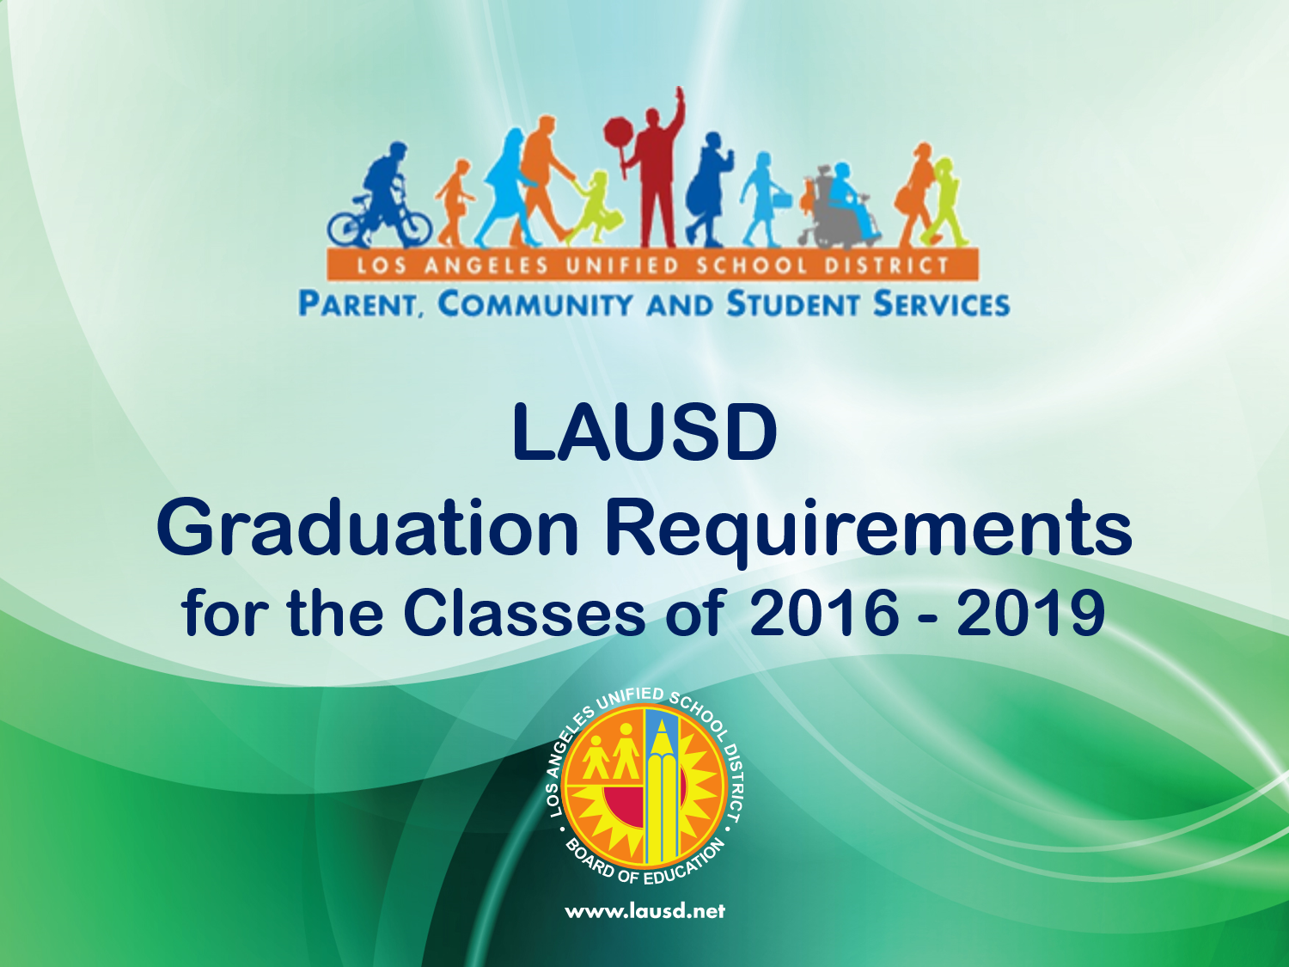

Slide 2

SESSION OBJECTIVES
Understand the graduation requirements for LAUSD students
Increase your awareness of how students are programmed into high school classes
Gain knowledge on how you can set high, but realistic, expectations to help your child achieve academic success leading to graduation
Learn how you can partner with your child’s school to learn more about college- and career-readiness.
2

Slide 3

T-I-P-S
(Think – Ink – Pair – Share)
When is the right
time to begin talking to your child about college and careers?
3

Slide 4
Pathway to College And Careers
Starts in Preschool
Key steps in Pathway to College and Careers:
  Kindergarten readiness
  Reading proficiently by the end of 3rd grade
  Leaving ES, with good grades, ready for MS work
  Leaving MS, with good grades, ready for HS curriculum
  Graduating HS, with good grades, college- and career-ready
  Families must be informed partners, knowing and supporting academic achievement each step of the way.
4

Slide 5
My Dream/My Vision
What are some goals you have for your child after he/she graduates from high school?
5
Notes:
Time: 3 minutes to think and write.
If participants are sitting in small groups, provide at least 30 seconds for each participant to share with the group.
If participants are sitting in rows, ask them to form pairs or triads to share. Provide between 1 and 2 minutes for sharing.
Be sure that there are no participants left without a partner!

Slide 6
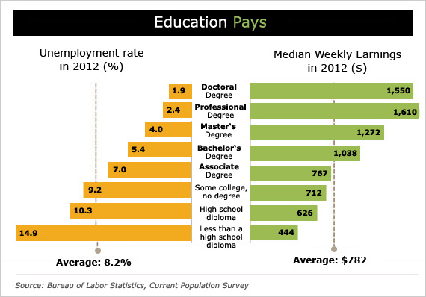
The Importance of a College Education
Education
level
What do you notice about the unemployment rate as the level of education increases?
What do you notice about weekly earnings as the level of education increases?
6

Slide 7
College- and Career-Readiness High School Coursework
“a-g”
California State University (CSU) and University of California (UC) Admission Guidelines
CDE
(California Department of Education)
Graduation Requirements
a – History/Social Science |  | 2 years
b – English |  | 4 years
c – Math |  | 3 years
d – Lab Science |  | 2 years
e – Language other than English (LOTE) |  | 2 years
f – Visual and Performing Arts |  | 1 years
g – College Preparatory Elective |  | 1 years
History/Social Science |  | 1 year Government/ Economics
Physical Education (PE) |  | 2 years
Additional
Graduation Requirements
Health |  | ½ year
Service Learning Requirement |  | Usually incorporated into a history course
Career Pathway Selection |  | Conversation with high school counselor
Students’ schedules include “a-g” requirements, courses required by the state of California, and additional requirements.
7

Slide 8
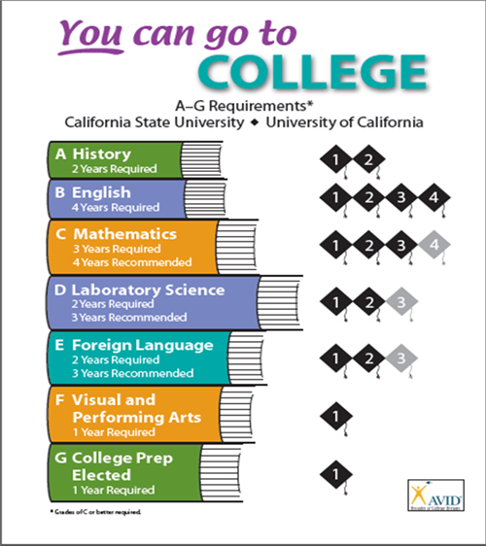

Slide 9

College-Readiness Alignment
LAUSD’s high school graduation requirements align with the minimum course requirements needed to apply to a Cal State University or University of California. However, fulfillment of the requirements does not guarantee acceptance.
For competitive colleges/universities, it is recommended that students take courses beyond the minimum course requirements.
LAUSD Graduation Requirements | Recommended
3 years of mathematics, including Algebra 1 | 4 years of mathematics, including Algebra 1
2 years of a Language other than English (LOTE) | 3+ years of a Language other than English (LOTE)
2 years of a Laboratory Science | 3 years of a Laboratory Science
9

Slide 10
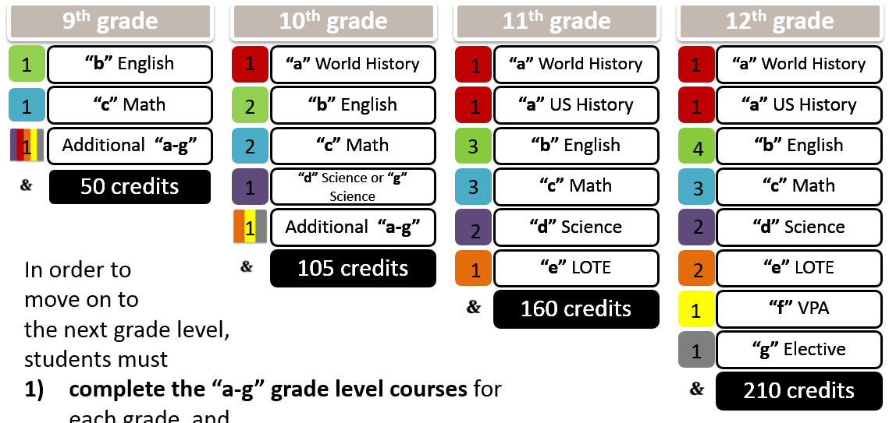
A-G Grade Level Benchmarks
In order to
move on to
the next grade level,
students must
complete the “a-g” grade level courses for each grade, and
earn the total number of credits required to promote to the next grade level.
10

Slide 11

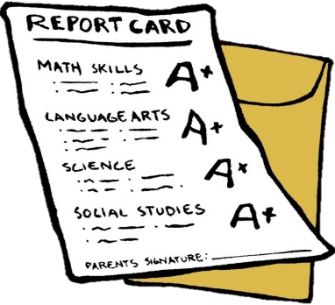
An Important Note On Grades
Universities, including CSUs and UCs, do not consider a D a passing grade and will not accept any “a-g” course in which the student has earned less than a C.
Students who graduate with Ds in their a-g courses can still pursue other post-high school educational opportunities, like community colleges, and transfer to a university in the future.
D
B
A
C
11

Slide 12
T-I-P-S
(Think – Ink – Pair – Share)
What can a
student with a “C” grade demonstrate about his/her learning that a “D” student cannot?
12

Slide 13
Foster Youth
Assembly Bill 216 (AB216), passed and approved in September of 2013, changed the CA Education Code for students in foster care.
Students meeting the eligibility criteria may be exempt from some of the graduation requirements.
If they choose to accept the exemption, they must be notified of the effect on gaining admission to college.
For more information read BUL-6566.1, which can be accessed by using the “Search” feature on the upper-right of the LAUSD home page screen.
13

Slide 14
Students With Disabilities (SWD)
Every student has his or her own specific needs. A student with an Individualized Education Plan (IEP) may apply for a waiver from some “a-g” course requirements if it is specified in his or her IEP.
Students in special day and resource programs who do not complete the District’s course requirements for graduation, even after being eligible for a waiver(s), may finish high school with a certificate of completion.
For more information, read BUL-6257.0, which can be accessed by using the “Search” feature on the upper-right of the LAUSD home page screen.
14

Slide 15
Review of the Major Changes
Coursework—all students must complete the minimum “a-g” course requirements with a grade of D or better.
Credits—210 credits are required to graduate.
C or better—to be eligible to apply to universities, students must pass their “a-g” courses with a C or better.
15

Slide 16
Remember…
You can:
Provide a home environment that encourages learning.
Set realistic expectations for your child’s school achievement and future career.
Be involved in your child’s education in the school and in the community.
Henderson, A. T. & Berla, 1997
16

Slide 17
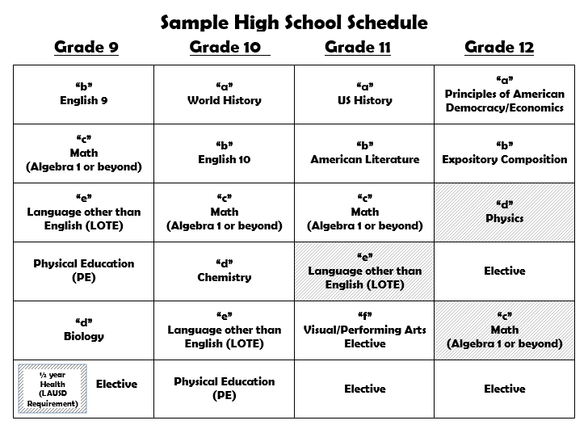

What More Do I Need To Know About the Path to Graduation?
Additional Requirements
Service Learning Project
Career Pathway
Recommendations
SAT/ACT (college admissions tests)
Extracurricular Activities
3.0 GPA or higher
Free Application for Federal Student Aid (FAFSA)
17

Slide 18
Extracurricular Activities
Sports
Volunteering
School Clubs
Colleges seek to admit students who have variety of interests and talents.
Encourage
your child to use his or her strengths to give back to the community.
Remember to keep a healthy balance between activities and academics, with high grades always coming first!
18

Slide 19
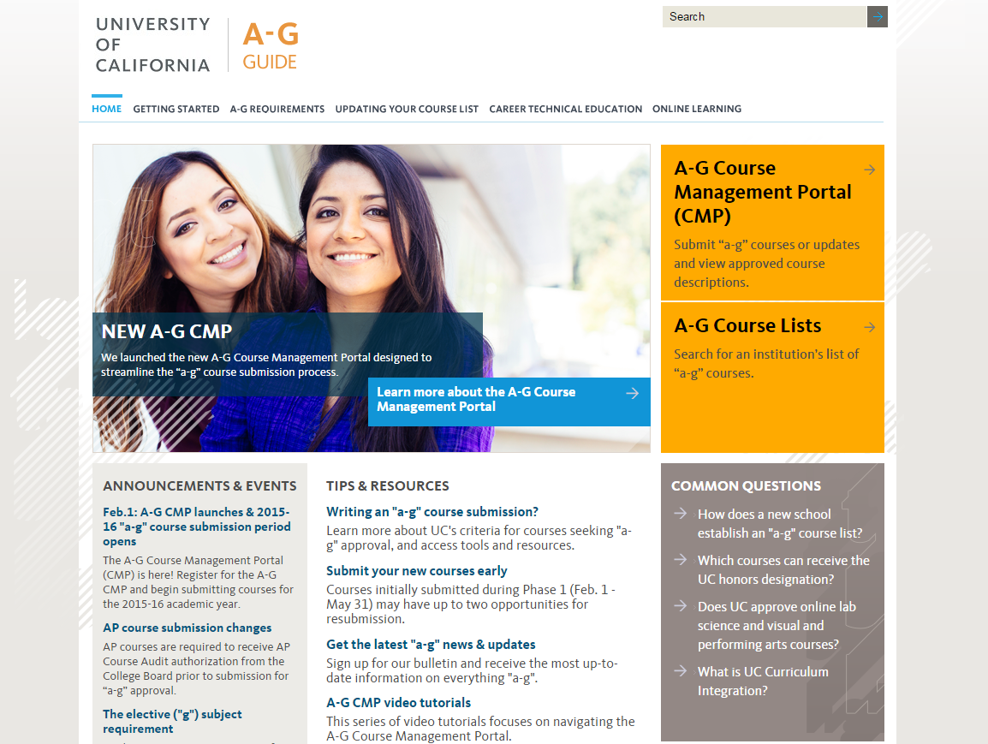
All schools’ a-g approved courses are available on the University of California Online Portal (UCOP) website:
http://ucop.edu/doorways/
Click here.
19

Slide 20
Personal Commitment to Action
What will you do in the near future to make your dream or vision come true?
I will call my child’s school tomorrow and…
When my child gets home, I will…
Tonight, I will…
20

Slide 21

Parent and Community Engagement Contact Information:
LD Northeast: Antonio Reveles (818) 252-5466
LD Northwest: Marilú Pigliapoco (818) 654-3608
LD South: Theresa Arreguin (310) 354-3511
LD East: Gilberto Martinez (323) 224-3338
LD West: Traci Calhoun (310) 914-2119
LD Central: Ismael Berver (213) 241-0126
20

